Slide 1
E-physiotherapy
Rahat karim gil-dsai-258
Zain-ul-abbdin gil-dsai-000
David ali gil-dsai-075
Supervised by
Faiza ali

Slide 2
Introduction
Machine learning is revolutionizing the healthcare industry and has the potential to take over technology
Physiotherapists play a crucial role in teaching patients the proper way of exercising for effective recovery
Monitoring patients' progress outside the clinic can be challenging without the use of AI-based applications
AI can change the role of physiotherapists and enable them to focus on the human element of patient care
Let's explore how AI-based applications can enhance physiotherapy programs and improve patient recovery.

Slide 3
Objectives
The project’s objective is to explore how digital physiotherapy intervention is supportive and improves the quality of healthcare in the current clinical setup.
To provide physiotherapy sessions that are conducted independently with instructions and guidance using real-time video processing via a camera on a computer.
Use of Machine Learning (ML) to augment traditional physiotherapy.
Real-time, remote physiotherapy sessions through a desktop-based Python application.

Slide 4
Literature review
Existing Systems
SWORD Health
The system uses wireless motion trackers that patients attach to their bodies. A “digital therapist” gives feedback in real-time.
Kaia Health
App that tracks the motion of points on the body using an iOS or Android device’s front-facing camera.

Slide 5
Methodology
SVM(support vector machine)
CV2
Mediapipe
FPS(frame per second)
Tkinter(GUI)
Tools/Technology
Python
Database (Mysql)
Machine learning

Slide 6
Problem Statement
Traditional Physiotherapy Limitations
Accessibility and Affordability
Inefficient Treatment Timings
Lack of Real-time Monitoring
Need for Technological Integration
Delayed Initiation of Treatment

Slide 7
Key Features
Remote exercise monitoring
Ease of use
Cost-effectiveness
Benefits
Faster recovery
Convenience for patients
Enhanced communication between patients and therapists

Slide 8

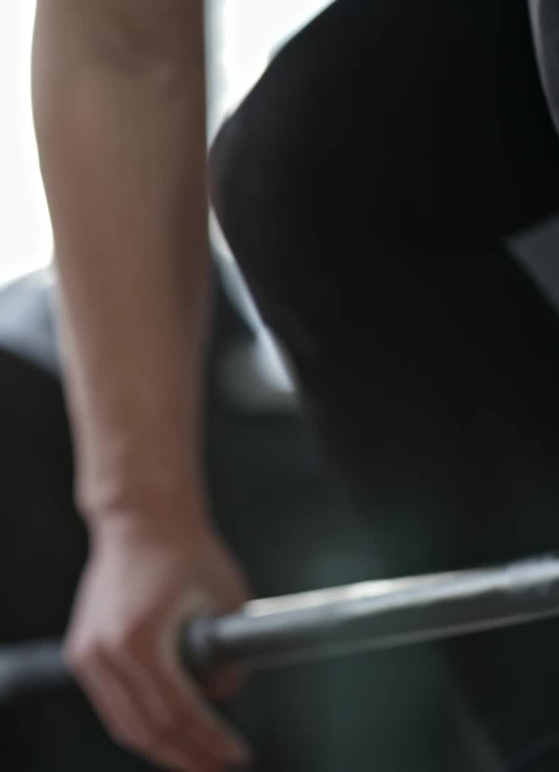
Brief Feasibility Study
Requirement
User must be logged in/sign up for the app first to maintain his/her history of therapy.
User should be able to calculate his/her flexibility through BMI which will be defined by weight and height.
Choose exercises user must be allowed to select rehabilitation muscles and limbs for therapy sessions
User must be given access camera.

Slide 9
Conclusion
Summarize the E-Physiotherapist project as a smart, new way to conduct physiotherapy at home using the internet.
Highlight benefits such as faster recovery, ease of use, and cost-effectiveness for both patients and therapists.
revolutionize the healthcare industry
modern advancements

